Slide 1

Chapter 1
Introduction
1.<number>
Copyright © The McGraw-Hill Companies, Inc. Permission required for reproduction or display.
Notes:
1.#

Slide 2
1-1 DATA COMMUNICATIONS
The term telecommunication means communication at a distance. The word data refers to information presented in whatever form is agreed upon by the parties creating and using the data. Data communications are the exchange of data between two devices via some form of transmission medium such as a wire cable.
Fundamental Characteristics:
Delivery, Accuracy, Timeliness, Jitter
Topics discussed in this section:
Components (Message, Sender, Receiver, Transmission Medium, Protocol).
Data Représentation (Text, Number, Images, Audio, Video)
Data Flow (Simplex, Duplex, Half Duplex)
1.<number>
Notes:
1.#

Slide 3
Components
4. Transmission medium. The transmission medium is the physical path by which a message travels from sender to receiver. Some examples of transmission media include twisted-pair wire, coaxial cable, fiber-optic cable, and radio waves.
5. Protocol. A protocol is a set of rules that govern data communications. It represents an agreement between the communicating devices. Without a protocol, two devices may be connected but not communicating, just as a person speaking French
cannot be understood by a person who speaks only Japanese.
1. Message. The message is the information (data) to be communicated. Popular forms of information include text, numbers, pictures, audio, and video.
2. Sender. The sender is the device that sends the data message. It can be a computer, workstation, telephone handset, video camera, and so on.
3. Receiver. The receiver is the device that receives the message. It can be a computer, workstation, telephone handset, television, and so on.
1.<number>

Slide 4

Figure 1.1 Five components of data communication
1.<number>
Notes:
1.#

Slide 5
Data Representation
Text (Unicode, American Standard Code for Information Interchange (ASCII))
Numbers
Images ( Divided into pixel with size in bit patterns, has color scheme of RGB- red,
green, and blue or YCM- yellow, cyan, and magenta.
Audio
Video
1.<number>

Slide 6
Data Flow
Simplex
Duplex
  Half Duplex
  Full Duplex
1.<number>

Slide 7

Figure 1.2 Data flow (simplex, half-duplex, and full-duplex)
1.<number>
Notes:
1.#

Slide 8
1-2 NETWORKS
A network is a set of devices (often referred to as nodes) connected by communication links. A node can be a computer, printer, or any other device capable of sending and/or receiving data generated by other nodes on the network.
Topics discussed in this section:
Distributed Processing
Network Criteria (performance, reliability, security)
Physical Structures (Type of Connection: Multipoint, Point to Point. Topology: Mesh, Star, Bus, Ring, Hybrid)
Network Models (OSI, TCP/IP)
Categories of Networks (PAN, LAN, MAN, WAN)
Interconnection of Networks: Internetwork
1.<number>
Notes:
1.#

Slide 9

Figure 1.3 Types of connections: point-to-point and multipoint
1.<number>
Notes:
1.#

Slide 10

Figure 1.4 Categories of topology
1.<number>
Notes:
1.#

Slide 11
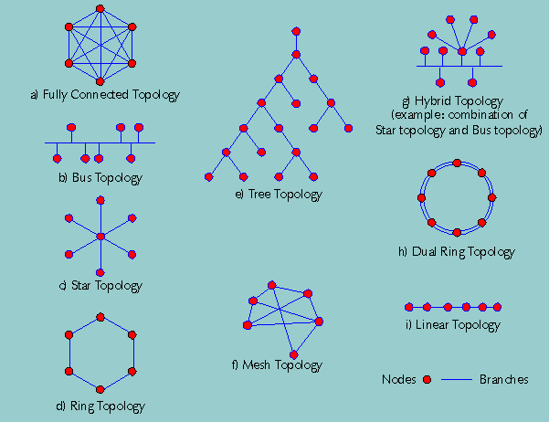
1.<number>

Slide 12

Figure 1.5 A fully connected mesh topology (five devices)
1.<number>
Notes:
1.#

Slide 13

Figure 1.6 A star topology connecting four stations
1.<number>
Notes:
1.#

Slide 14

Figure 1.7 A bus topology connecting three stations
Back Bone Cable are connected to Drop line through Taps.
Signal becomes weak as it travels further distance.
Advantages: Ease of Installation. Uses less cables. Less complex.
Disadvantages: Difficult to fault isolation and reconnection. Difficult to add new devices.
Signal reflection at tapes reduces the signal quality. A fault or break in the bus cable stops all transmission.
1.<number>
Notes:
1.#

Slide 15

Figure 1.8 A ring topology connecting six stations
Easy to install and reconfigure. Fault isolation is simplified. If one device does not receive a signal within a specified period,
it can issue an alarm. The alarm alerts the network operator to the problem and its location.
The only constraints are media and traffic considerations (maximum ring length and number of devices).
Unidirectional traffic can be a disadvantage. In a simple ring, a break in the ring (such as a disabled station) can disable the
entire network. Solution: Dual Ring.
1.<number>
Notes:
1.#

Slide 16

Figure 1.9 A hybrid topology: a star backbone with three bus networks
1.<number>
Notes:
1.#

Slide 17

Figure 1.10 An isolated LAN connecting 12 computers to a hub in a closet
1.<number>
Notes:
1.#

Slide 18

Figure 1.11 WANs: a switched WAN and a point-to-point WAN
1.<number>
Notes:
1.#

Slide 19

Figure 1.12 A heterogeneous network made of four WANs and two LANs
1.<number>
Notes:
1.#

Slide 20
1-3 THE INTERNET
The Internet has revolutionized many aspects of our daily lives. It has affected the way we do business as well as the way we spend our leisure time. The Internet is a communication system that has brought a wealth of information to our fingertips and organized it for our use.
Topics discussed in this section:
A Brief History
The Internet Today (ISPs)
1.<number>
Notes:
1.#

Slide 21
Brief History
Came into existence in 1969 only after Packet Switched Network was invented in 1961 at MIT by Leonard Kleinrock.
DoD (Dept of Defense) through ARPA (Advanced Research Projects Agency) represented ARPANET in ACM (Association of Comuting Machinery) meeting in 1967.
Introduced IMP (Interface Message Processor).
In 1969, UCLA – UCSB – SRI – UoU got connected.
  University of California Los Angeles – UCLA
  University of California Santa Barbara – UCSB
  University of Utah – UoU
  Sanford Research Institute (SRI)
Software Support by NCP – Network Control Protocol.
1972, Vint Cerf and Bob Kahn came up with paper on TCP with networking concepts of encapsulation, datagram, gateways, end to end delivery of packets.
Soon TCP was split into TCP and IP.
In 1981, UC Berkeley modified the UNIX operating system to include TCP/IP which popularized Internetworking.
Then came creation of CSNET in 1981. Computer Science Network (CSNET) was a network sponsored by the National Science Foundation (NSF).
In 1983, ARPANET split into two networks: Military Network (MILNET) for military users and ARPANET for nonmilitary users.
Today, it is managed by ISP – Internet Service Providers.
1.<number>

Slide 22

Figure 1.13 Hierarchical organization of the Internet
ISP – Internet Service Provider
NAP – Network Access Point
ISP Communicate with each
others network through NAP
1.<number>
Notes:
1.#

Slide 23
Standards Organization
ISO – International Organization of Standardization
ITU-T – International Telecommunication Union Telecommunication Standards formed CCITT in 1993 for research.
CCITT – Consultative Committee for International Telegraphy and Telephony.
ANSI – American National Standards Institutions.
IEEE – Institute of Electric and Electronics Engineers
EIA – Electronic Industries Association
FCC – Federal Communication Commission
RFC – Request for Comment
How about Controlling body in India?
1.<number>

Slide 24
Standards Organization in INDIA
Press Council of India (PCI),
News Broadcasting Standards Authority (NBSA),
Central Board of Film Certification (CBFC),
Telecom Regulatory Authority of India (TRAI),
Indian Broadcasters Federation (IBF),
News Broadcasters Association (NBA),
Indian Media Group (IMG),
Indian Society of Advertisers (ISA),
The Advertising Standards Council of India (ASCI),
Advertising Agencies Association of India (AAAI),
Media Research Users Council (MRUC),
Audit Bureau of Circulations (ABC),
Press Trust of India (PTI),
Confederation of Indian Industry (CII),
the Associated Chambers of Commerce and Industry of India (ASSOCHAM),
Federation of Indian Chambers of Commerce and Industry (FICCI),
United News of India (UNI)
1.<number>

Slide 25
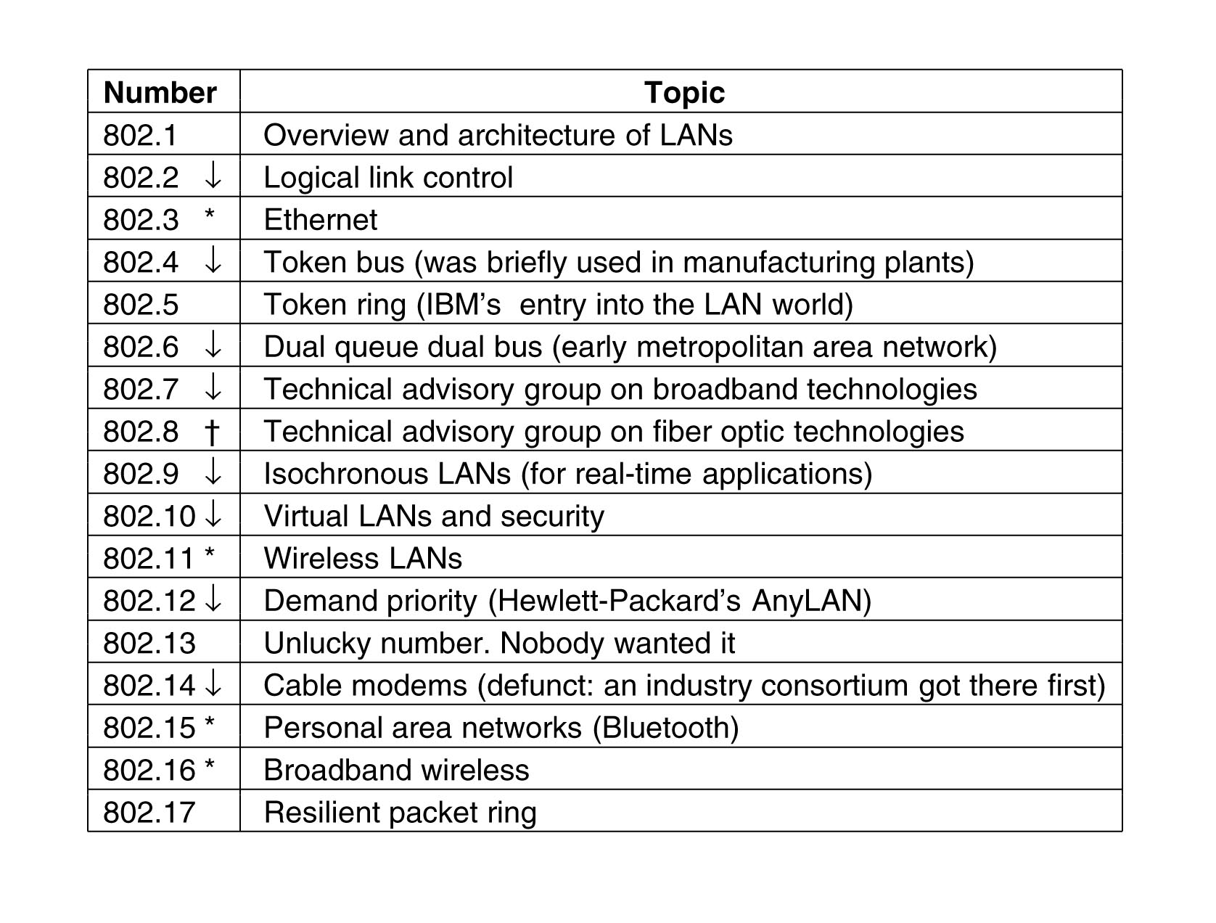
1.<number>

